Slide 1
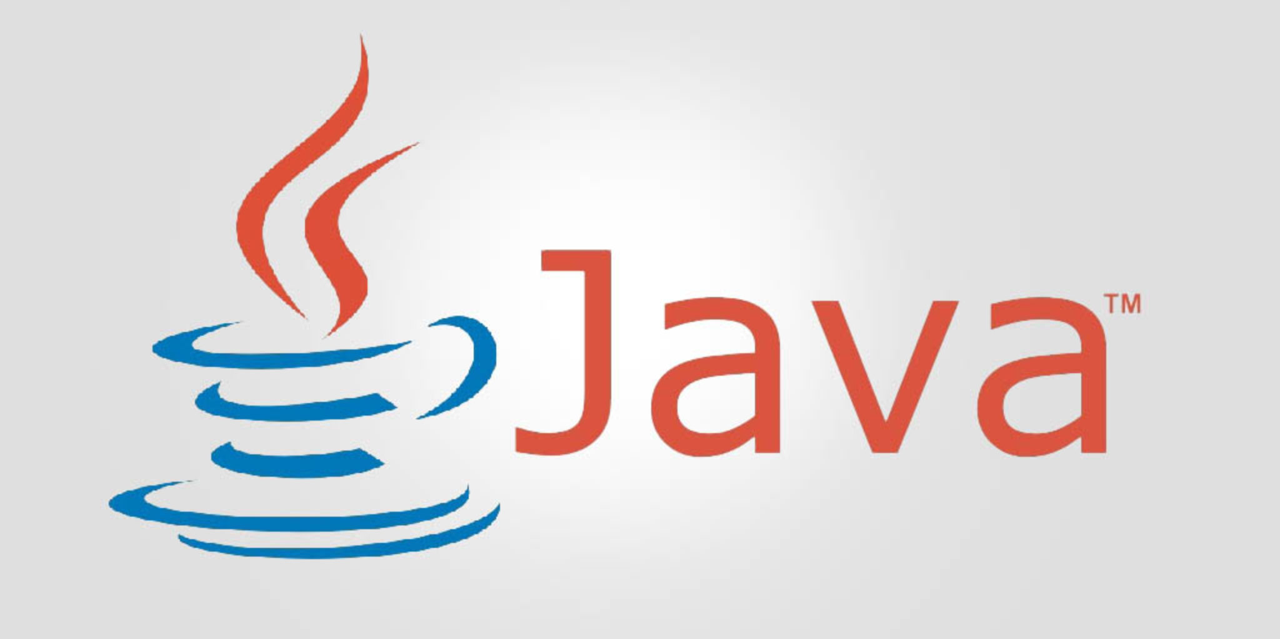
Introduction to Java
This Photo by Unknown Author is licensed under CC BY-SA

Slide 2

What is Java?
High-level, object-oriented programming language
Developed by Sun Microsystems (now Oracle)
Used for a wide range of applications
Follows the principle: Write Once, Run Anywhere (WORA)

Slide 3
How Java Works
Java source code → compiled into Bytecode
Bytecode runs on the Java Virtual Machine (JVM)
JVM makes Java platform independent

Slide 4
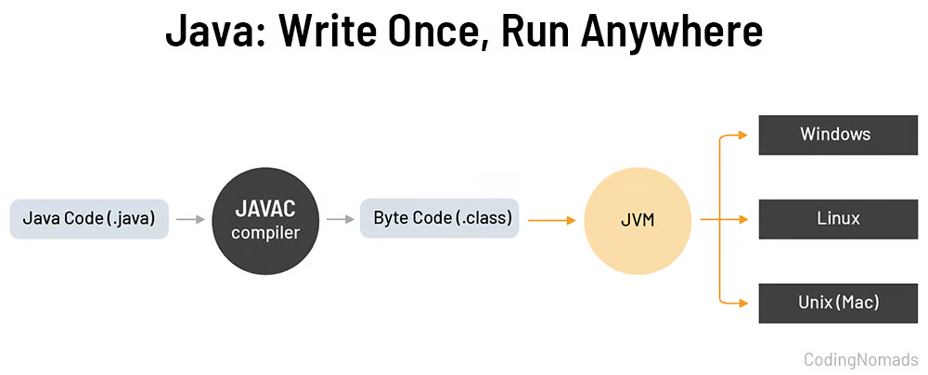

Slide 5
Key Characteristics of Java
Object-Oriented → classes, objects, inheritance, polymorphism
Platform Independent → runs anywhere with JVM
Secure and Robust → automatic memory management (Garbage Collection), exception handling
Reliable → fewer crashes, strong error checking

Slide 6
Object-Oriented Programming (OOP)
Core concepts in Java OOP:
Classes & Objects
Encapsulation
Inheritance
Polymorphism
Abstraction

Slide 7
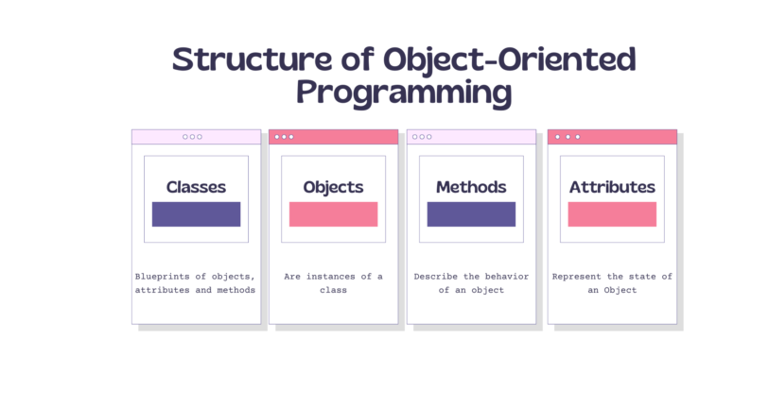

Slide 8
Applications of Java
Enterprise Applications (Banking, ERP systems)
Android Development (apps & games)
Web Applications (server-side, dynamic websites)
Big Data (Hadoop, Spark in Java)
Cloud Computing (deploying apps in the cloud)
IoT (smart devices, embedded systems)

Slide 9
Tools for Java Development
JDK (Java Development Kit)Contains compiler, debugger, libraries
JRE (Java Runtime Environment)Runs Java programs
JVM (Java Virtual Machine)Executes Java bytecode

Slide 10
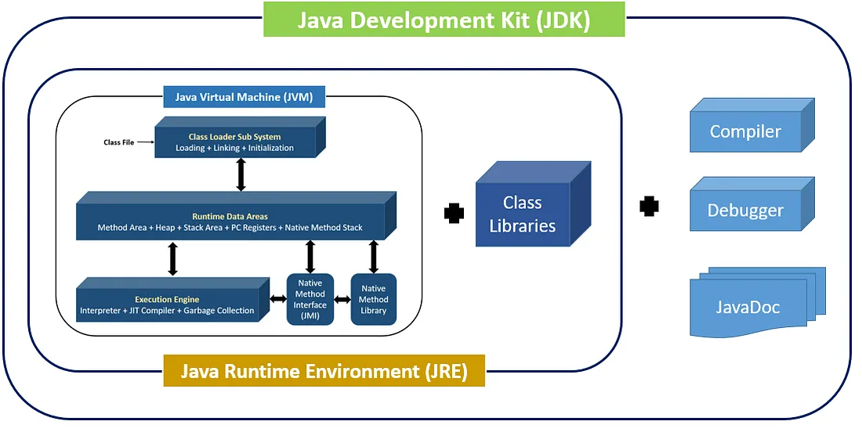

Slide 11
Why Learn Java?
Popular in industry (millions of developers worldwide)
Strong foundation for AP CS A and real-world coding
Opens doors to careers in software development, AI, cloud, mobile apps, and more

